Slide 1
ANLY 5332
Department of Information Systems and Analytics
McCoy College of Business
Texas State University
Nonlinear Optimization

Slide 2
Outline
Nonlinear Programming Introduction (Chapter 8.1)
  Nonlinear functions and Local vs. Global Optimality
Excel Solver’s Nonlinear Optimization (Chapter 8.2)
Separable Programming (Chapter 8.3)
Scipy for Nonlinear Optimization (not in the textbook)
Cases
  Economic Order Quantity Model (not in the textbook)
  Simple Linear Regression Model (not in the textbook)

Slide 3
Outline
Nonlinear Programming Introduction (Chapter 8.1)
  Nonlinear functions and Local vs. Global Optimality
Excel Solver’s Nonlinear Optimization (Chapter 8.2)
Separable Programming (Chapter 8.3)
Scipy for Nonlinear Optimization (not in the textbook)
Cases
  Economic Order Quantity Model (not in the textbook)
  Simple Linear Regression Model (not in the textbook)

Slide 4
Nonlinear Programming
In linear programming
  All of the functions (objective function and constraints) are linear
  Constant marginal returns
    Constant per unit profit
    Constant per unit cost
    Constant per unit resource usage
Nonlinear programming is used to model nonproportional relationships between
  Activity levels and the overall measure of performance (objective function)
  Activity levels and the resources usage or contributions (constraints)
In non-linear programming
  Some functions are nonlinear
  Varying marginal returns
Proportionality of the linear functions

Slide 5
Nonlinear Programming
Linear relations:

Slide 6
Nonlinear Functions
Nonlinear relations:
Piecewise Linear with
Decreasing Marginal Returns
Decreasing Marginal Returns

Slide 7
Nonlinear Functions
Nonlinear relations:
Decreasing Marginal Returns
Except for Discontinuities
Increasing Marginal Returns

Slide 8
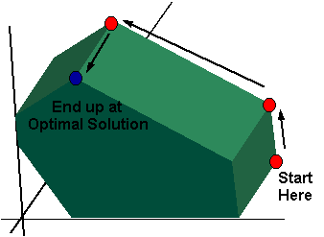
Nonlinear Functions
Constructing the nonlinear formula(s) needed for a nonlinear programming model is considerably more difficult than developing the linear formulas used in linear programming.
Solving a nonlinear programming model is often much more difficult (if it is possible at all) than solving a linear programming model.
We cannot use Simplex method:
We may not have those nice corner points as in the case of linear programming or the objective function will not be optimized at a corner point

Slide 9
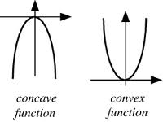
Nonlinear Functions
Two important class of nonlinear functions:
  Convex: Increasing marginal returns
    A function is convex if the line connecting any two points on the function falls entirely above the function (u-shaped)
  Concave: Decreasing marginal returns
    A function is concave if the line connecting any two points on the function falls entirely below the function (n-shaped)

Slide 10
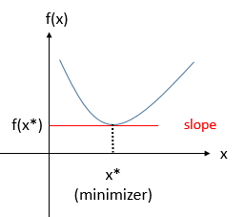
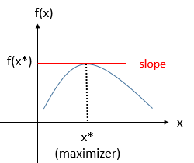
Nonlinear Functions
Single variable unconstrainted models:
  Minimizing a convex function
  take the first derivative,
  →make it equal to 0
  Maximizing a concave function
  take the first derivative
  make it equal to 0

Slide 11
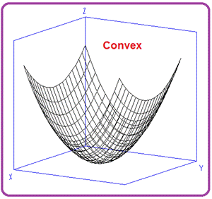
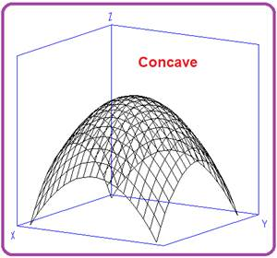
Nonlinear Functions
More than one variables:
For 2-dimensional problems, the objective function can be visualized with the help of level curves also referred as contours or heat maps

Slide 12
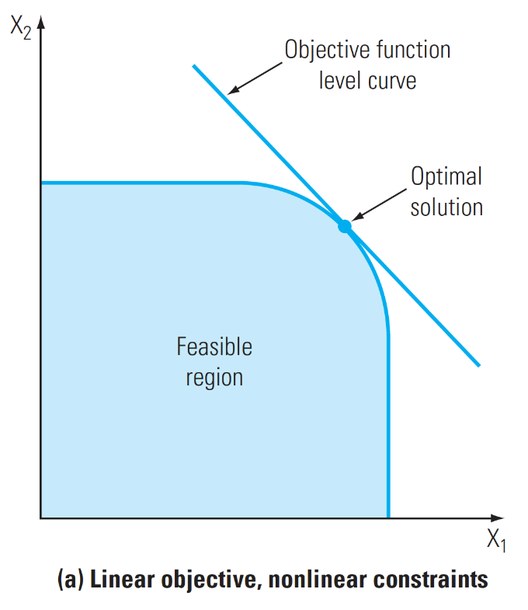
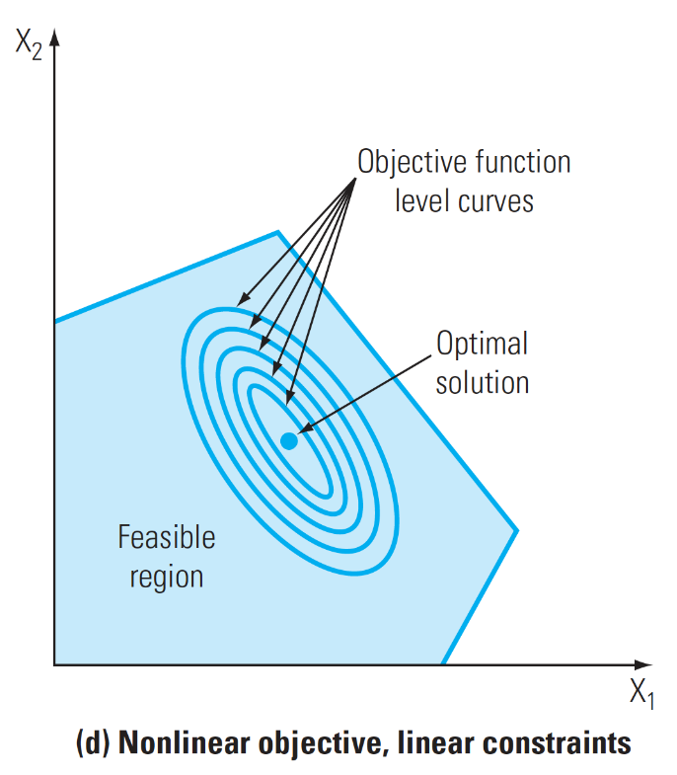
Nonlinear Functions
No One-Size-Fits-All Method:
  There is no algorithm that can solve an arbitrary non-linear program
  Efficient algorithms exist for solving convex optimization problems
    These algorithms provide “good” but not necessarily optimal solutions to non-convex problems.
Corner Points are not well-defined
Optimal Solution could be interior

Slide 13
Local vs. Global Optimality
Local Optima:
  a solution that is better than any other feasible solution in its local neighborhood.
Global Optima:
  a solution that is better than any other feasible solution in the entire feasible region
Maximize 0.5x⁵ – 6x⁴ + 24.5x³ – 39x² + 20x
subject to x ≤ 5
x ≥ 0
Nonlinear function

Slide 14
Local vs. Global Optimality
Local and global optimal solutions
  Local maximum vs. global maximum and Local minimum vs. global minimum
Global maximum
Local maximum
Local maximum
Local minimum
Local minimum
Global minimum

Slide 15
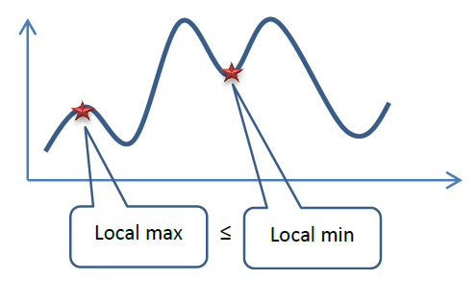
Local vs. Global Optimality
Local and global optimal solutions
  A global optimum is also a local optimum
    But a local optimum is not necessarily a global optimum
  There might be multiple local optima as well as multiple global optima (in case of alternative optima)
  A local minimum can be greater than a local maximum

Slide 16
Outline
Nonlinear Programming Introduction (Chapter 8.1)
  Nonlinear functions and Local vs. Global Optimality
Excel Solver’s Nonlinear Optimization (Chapter 8.2)
Separable Programming (Chapter 8.3)
Scipy for Nonlinear Optimization (not in the textbook)
Cases
  Economic Order Quantity Model (not in the textbook)
  Simple Linear Regression Model (not in the textbook)

Slide 17
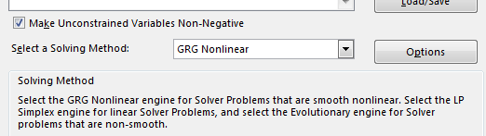
Excel Solver’s Nonlinear Optimization
Excel Solver has a solving method for nonlinear models
  GRG Nonlinear
  Infeasibility and unboundedness outcomes are the same:
    “Solver could not find a feasible solution” for infeasibility
    “Objective Cell values do not converge” for unboundedness
Example: Multiple local maxima (Chapter 8.1)
Maximize Profit = 0.5x⁵ – 6x⁴ + 24.5x³ – 39x² + 20x
subject to x ≤ 5
x ≥ 0

Slide 18
Excel Solver’s Nonlinear Optimization
Depending on the starting solution, the returned solution can change
Starting with x=0
Starting with x=3
Starting with x=4.7

Slide 19
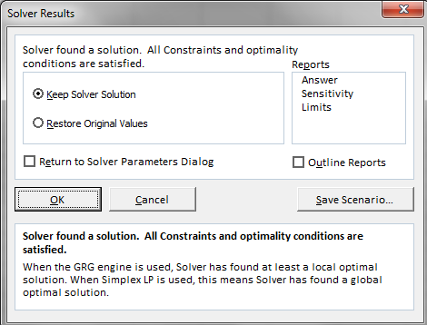
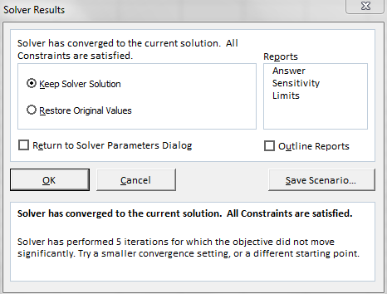
Excel Solver’s Nonlinear Optimization
Solver outputs:
  “Solver found a solution. All constraints and optimality conditions are satisfied.”
    Good message!
    A local optimal solution is identified.
  “Solver has converged to the current solution. All constraints are satisfied.”
    Not so-good message!
    Not necessarily a local optimal solution.
  “Solver cannot improve the current solution. All constraints are satisfied.”
    Worst message!
    Not necessarily a local optimal solution, solver is trapped in a cycle.

Slide 20
Excel Solver’s Nonlinear Optimization
How does it work?
  If objective is to maximize, starting from the starting solution, climb-up
  If objective is to minimize, starting from the starting solution, climb-down
  No guarantee that we will find the global optimum
  Unless
    We are maximizing a concave function subject to linear constraints
    We are minimizing a convex function subject to linear constraints

Slide 21
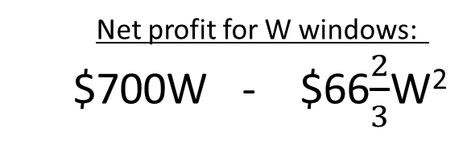
Excel Solver’s Nonlinear Optimization
Case: Wyndor Glass Co. with Marketing Costs (Chapter 8.2)
  We still have the plant time availability constraints
  D: number of doors
  W: number of windows
  Constraints:
    D ≤ 4 (Plant 1 availability)
    2W ≤ 12 (Plant 2 availability)
    3D + 2W ≤ 18 (Plant 3 availability)
  Net profit for D doors:
  $375D - $25D²
  Net profit for W windows:
  $700W - $66$\frac{2}{3}$W²
$375 is the gross profit for one door
$25D² is the marketing cost for D doors
$700 is the gross profit for one window
$66 2/3 W² is the marketing cost for W windows

Slide 22

Excel Solver’s Nonlinear Optimization
Case: Wyndor Glass Co. with Marketing Costs
Decreasing marginal returns
The algebraic model
  Maximize P = $375D - $25D² + $700W - $66$\frac{2}{3}$W²
  subject to D ≤ 4 (Plant 1 availability)
  2W ≤ 12 (Plant 2 availability)
  3D + 2W ≤ 18 (Plant 3 availability)
  D ≥ 0, W ≥ 0

Slide 23
Excel Solver’s Nonlinear Optimization
Case: Wyndor Glass Co. with Marketing Costs
Spreadsheet model
  Global optimum…

Slide 24
Outline
Nonlinear Programming Introduction (Chapter 8.1)
  Nonlinear functions and Local vs. Global Optimality
Excel Solver’s Nonlinear Optimization (Chapter 8.2)
Separable Programming (Chapter 8.3)
Scipy for Nonlinear Optimization (not in the textbook)
Cases
  Economic Order Quantity Model (not in the textbook)
  Simple Linear Regression Model (not in the textbook)

Slide 25
Separable Programming
Separable programming can be used in creating approximate (and sometimes equal) linear programming models for some nonlinear programming models
Case: Wyndor Glass Co. with Overtime (Chapter 8.3)
  Wyndor Glass has accepted a special order for hand-crafted goods to be made in plants 1 and 2 throughout the next four months. Filling this order will require borrowing certain employees from the work crews of regular products.
    The remaining workers will need to work overtime to utilize the full production capacity of each plant’s machinery for the regular products.
    The original constraints of Hours Used ≤ Hours Available are still valid. However, the objective function will need to be modified because of the additional cost of using overtime work.
    In particular, because of the additional cost, the profit per unit will be reduced for those units that require overtime.

Slide 26
Separable Programming
Case: Wyndor Glass Co. with Overtime (Chapter 8.3)
  We have the following data:
 | Maximum Weekly Production |  |  | Profit per Unit Produced
Product | Regular Time | Over-time | Total | Regular Time | Over-time
Doors | 3 | 1 | 4 | $300 | $200
Windows | 3 | 3 | 6 | 500 | 100

Slide 27
Separable Programming
How does separable programming work?
  For each activity that violates the proportionality assumption, separate its profit graph into parts, with a line segment in each part.
  Then, instead of using a single decision variable to represent the level of each such activity, introduce a separate new decision variable for each line segment on that activity’s profit graph.
  Since the proportionality assumption holds for these new decision variables, formulate a linear programming model in terms of these variables.
For the Wyndor problem, these new decision variables are
  D_{R} = Number of doors produced per week on regular time
  D_{O} = Number of doors produced per week on overtime
  W_{R} = Number of windows produced per week on regular time
  W_{O} = Number of windows produced per week on overtime

Slide 28
Separable Programming
Case: Wyndor Glass Co. with Overtime
Algebraic model:
Maximize profit=300D_{R} +200D_{O} +500W_{R} + 100W_{O}
subject to D_{R} <=3, D_{O} <=1, W_{R} <=3, W_{O} <=3
D_{R} +D_{O} <=4
2(W_{R} + W_{O} )<=12
3(D_{R} +D_{O})+ 2(W_{R} + W_{O})<=18
D_{R} >=0, D_{O} >=0, W_{R} >=0, W_{O} >=0
NOTE: This will work since we have decreasing marginal profit… We know that if D_{R} <=3, then D_{O} =0

Slide 29
Separable Programming
Case: Wyndor Glass Co. with Overtime
Spreadsheet model:

Slide 30
Separable Programming
Read Wyndor problem with both overtime costs and nonlinear marketing costs (pg288-291)
  Converting decreasing marginal profits to piecewise decreasing marginal profits (this is approximation)

Slide 31
Outline
Nonlinear Programming Introduction (Chapter 8.1)
  Nonlinear functions and Local vs. Global Optimality
Excel Solver’s Nonlinear Optimization (Chapter 8.2)
Separable Programming (Chapter 8.3)
Scipy for Nonlinear Optimization (not in the textbook)
Cases
  Economic Order Quantity Model (not in the textbook)
  Simple Linear Regression Model (not in the textbook)

Slide 32
Scipy for Nonlinear Optimization
To install Scipy using Anaconda:
  Open the anaconda prompt
  Type the following command:
    conda install -c anaconda scipy
We can use the optimization package to solve:
  linear programming problems (continuous variables)
  nonlinear programming problems (continuous variables)

Slide 33
Scipy for Nonlinear Optimization
scipy.optimize.minimize(fun, x0, method=‘’, bounds=None, constraints=())
  fun: objective function
  x0: initial values for decision variables
  method: specify a specific method, ‘SLSQP’ is a commonly used method, but there are more available
  bounds: bounds for the decision variables
  constraints: constraints
For further explanation visit
https://docs.scipy.org/doc/scipy/reference/generated/scipy.optimize.minimize.html

Slide 34
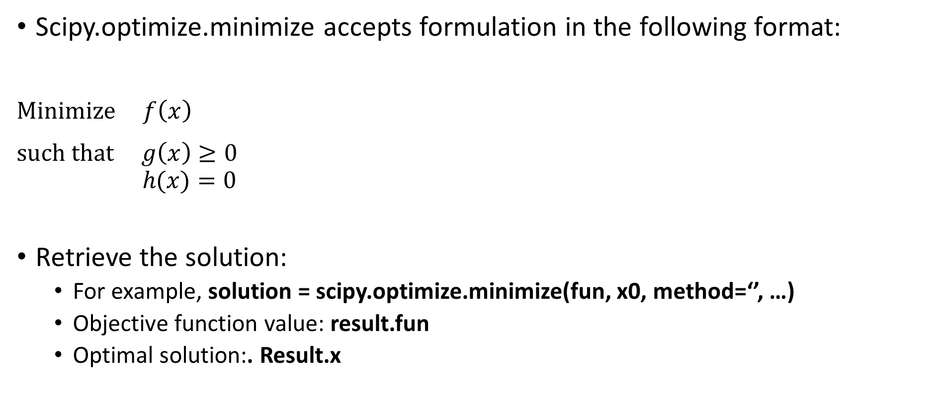
Scipy for Nonlinear Optimization
Scipy.optimize.minimize accepts formulation in the following format:
$Minimize f\left(x\right)$
$such that g\left(x\right)≥0$
$$h(x)=0$$
Retrieve the solution:
  For example, solution = scipy.optimize.minimize(fun, x0, method=‘’, …)
  Objective function value: result.fun
  Optimal solution:. Result.x
$$maximize F\left(x\right)↔minimize −F(x)$$
$$G\left(x\right)≤0 ↔−G\left(x\right)≥0$$

Slide 35
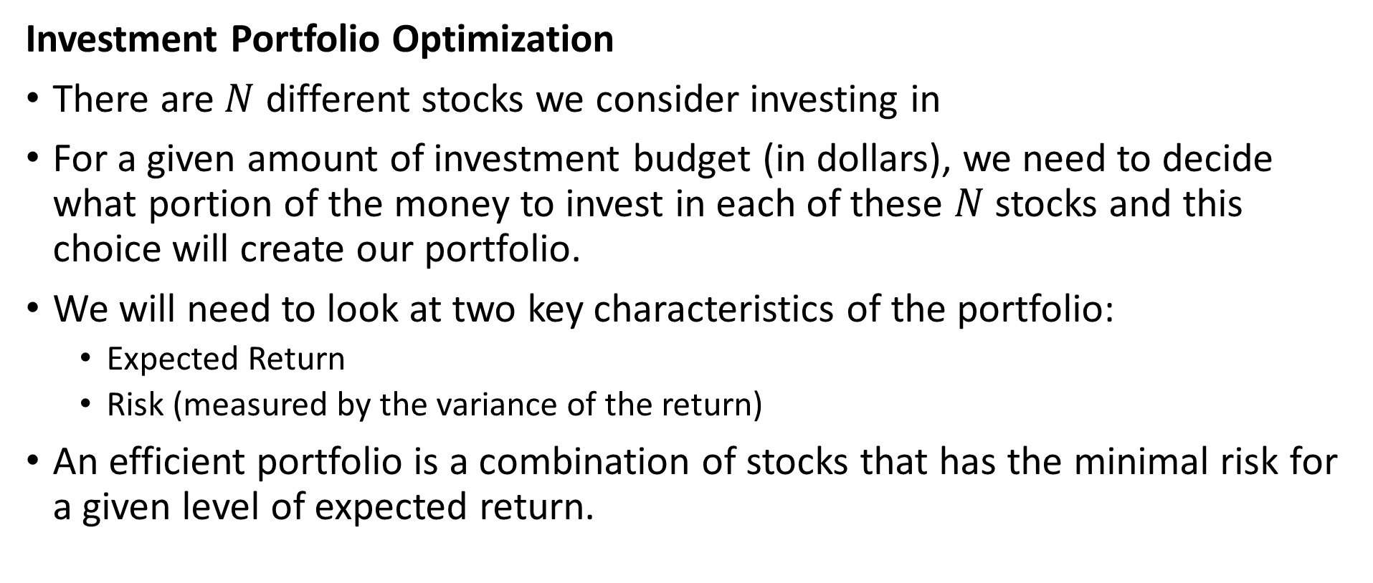
Scipy for Nonlinear Optimization
Investment Portfolio Optimization
There are $N$ different stocks we consider investing in
For a given amount of investment budget (in dollars), we need to decide what portion of the money to invest in each of these $N$ stocks and this choice will create our portfolio.
We will need to look at two key characteristics of the portfolio:
  Expected Return
  Risk (measured by the variance of the return)
An efficient portfolio is a combination of stocks that has the minimal risk for a given level of expected return.

Slide 36
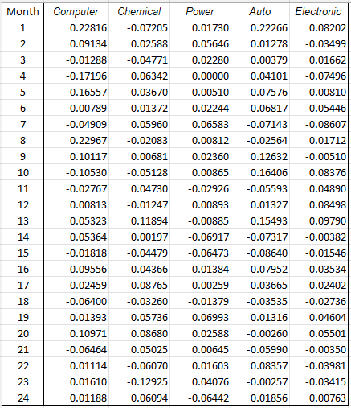

Scipy for Nonlinear Optimization
Investment Portfolio Optimization
We calculate the following statistics of this given dataset:
Mean monthly return of each stock
  $$Ε_{i}, where i=1, 2, 3, 4, 5$$
Covariance matrix of monthly returns
  $${cov}_{ij}, where i, j=1, 2, 3, 4, 5$$

Slide 37
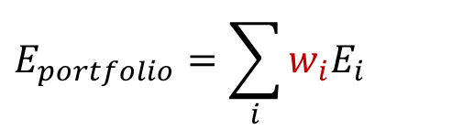
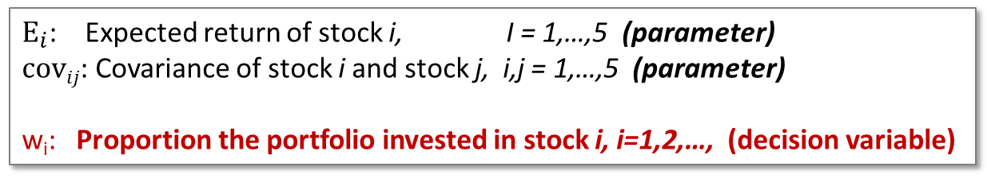
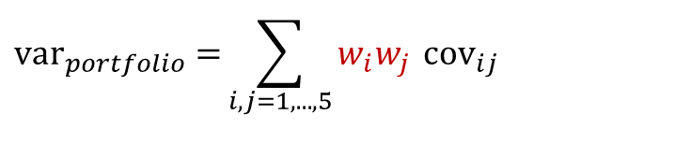
Scipy for Nonlinear Optimization
Investment Portfolio Optimization
Expected return:
Variance of return:
$Ε_{i}$: Expected return of stock i, I = 1,…,5 (parameter)
$covij$: Covariance of stock i and stock j, i,j = 1,…,5 (parameter)
w_{i}: Proportion the portfolio invested in stock i, i=1,2,…, (decision variable)
$$E_{portfolio}=\sum_{i}{w_{i}E_{i}}$$
$${var}_{portfolio}{=}\sum_{i,j=1,...,5}{w_{i}w_{j} }{cov}_{ij}$$
A nonlinear function
of w_{i}

Slide 38
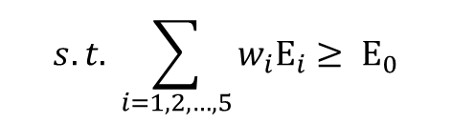



Scipy for Nonlinear Optimization
Investment Portfolio Optimization
For any given level of required return E₀ (in between the lowest individual stock return and the highest individual stock return), we will look for the portfolio that yields the lowest variance of return:
Decision variables:
Proportion of each stock in the portfolio
Objective:
Minimize Variance of the Portfolio
Constraints:
Expected Return of the Portfolio ≥ a given level
Sum of proportions is 1
Non-negative constraint
$$minimize\sum_{i,j=1,...,5}{w_{i}w_{j} }{cov}_{ij}$$
$$s.t. \sum_{i=1, 2, …, 5}{w_{i}Ε_{i}}≥ Ε_{0}$$
$$\sum_{i=1, 2, …, 5}{w_{i}}=1$$
$$w_{i}≥0, i=1, 2, 3, 4, 5$$

Slide 39
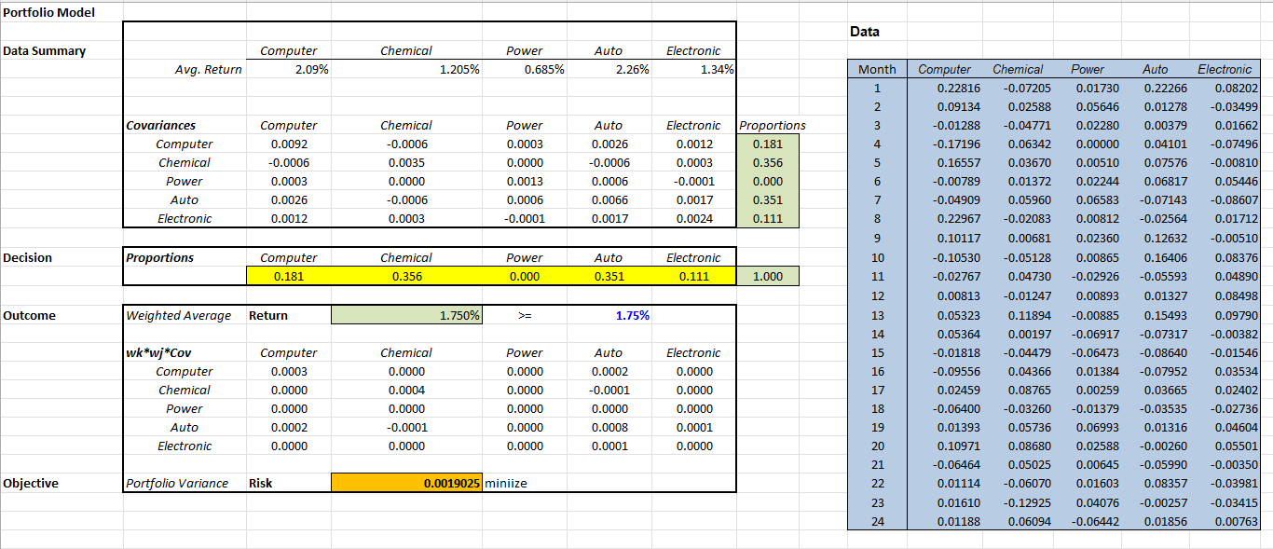
Scipy for Nonlinear Optimization
Investment Portfolio Optimization

Slide 40
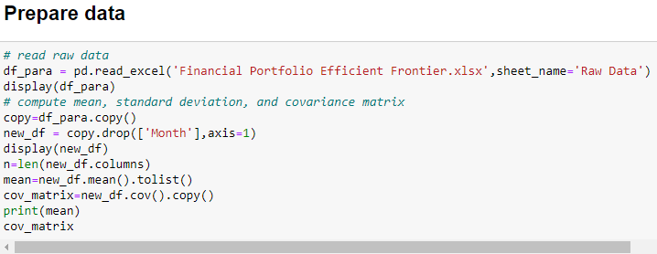
Scipy for Nonlinear Optimization
Investment Portfolio Optimization

Slide 41
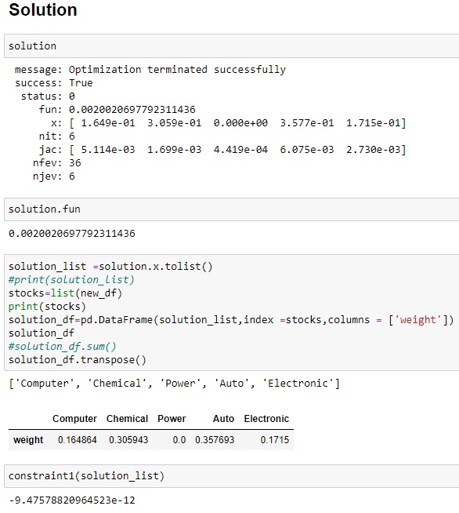
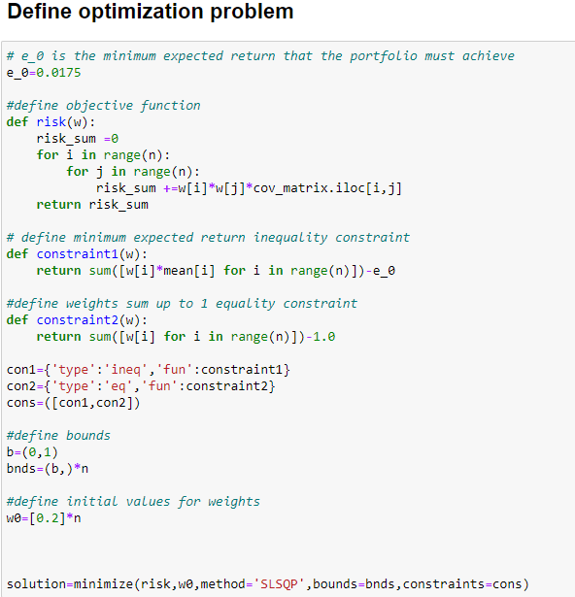
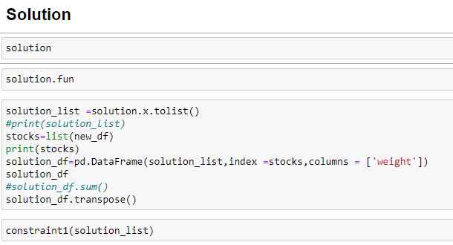
Scipy for Nonlinear Optimization
Investment Portfolio Optimization

Slide 42
Outline
Nonlinear Programming Introduction (Chapter 8.1)
  Nonlinear functions and Local vs. Global Optimality
Excel Solver’s Nonlinear Optimization (Chapter 8.2)
Separable Programming (Chapter 8.3)
Scipy for Nonlinear Optimization (not in the textbook)
Cases
  Economic Order Quantity Model (not in the textbook)
  Simple Linear Regression Model (not in the textbook)
KKT Overview

Slide 43
Economic Order Quantity Model
A very commonly used inventory control model
  Check your smart phones: there is an EOQ application
Economic Order Quantity Model:
  You know how many items you will sell in a year
  You know the cost of holding one item in inventory for one year
  You want to determine how many to ship each time when you replenish your inventory
  There is a fixed cost with each shipment
Question: What is the order quantity that will minimize your costs per unit time?

Slide 44
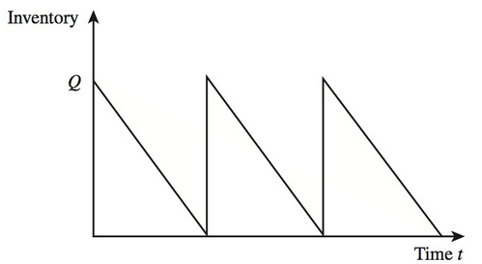
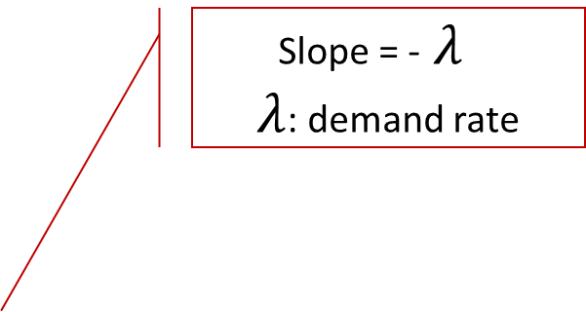

Economic Order Quantity Model
The inventory vs. time
Slope = - $λ λ$
$λ$: demand rate
Next order of Q units is received
$$T$$

Slide 45
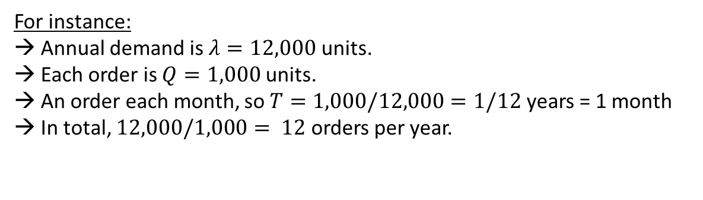
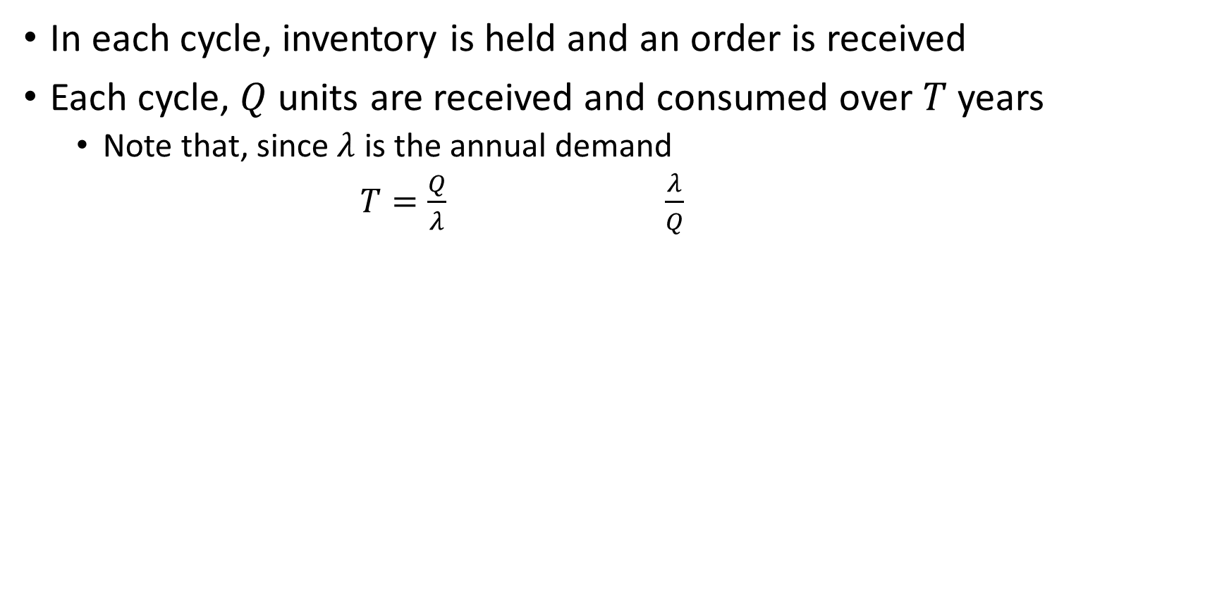
Economic Order Quantity Model
In each cycle, inventory is held and an order is received
Each cycle, $Q$ units are received and consumed over $T$ years
  Note that, since $λ$ is the annual demand
  $T=\frac{Q}{λ}$ $\frac{λ}{Q}$
Number of orders received in a year
Replenishment cycle length (in years)
For instance:
→ Annual demand is $λ=12,000$ units.
→ Each order is $Q=1,000$ units.
→ An order each month, so $T=1,000/12,000=1/12$ years = 1 month
→ In total, $12,000/1,000= 12$orders per year.

Slide 46
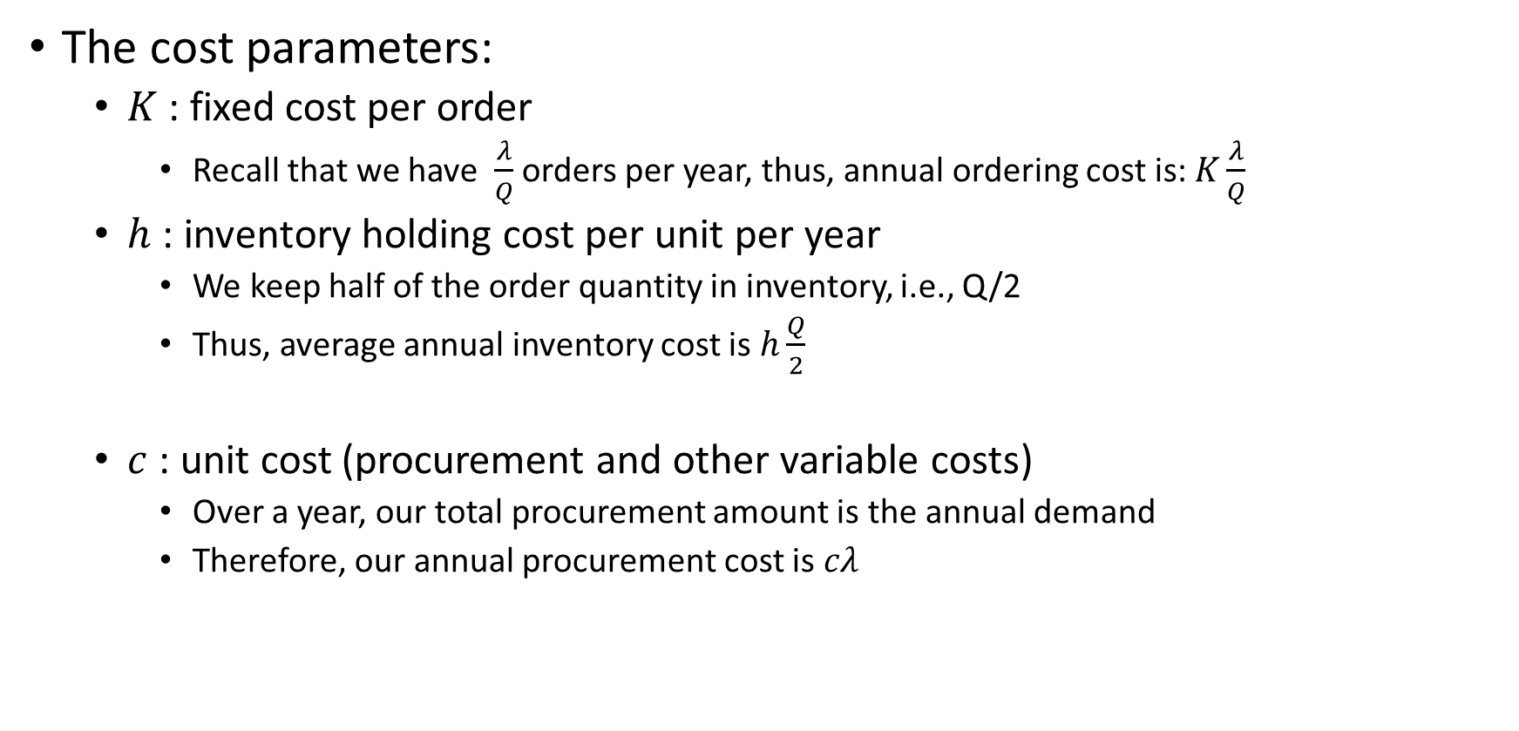
Economic Order Quantity Model
The cost parameters:
  $K$ : fixed cost per order
    Recall that we have $\frac{λ}{Q}$ orders per year, thus, annual ordering cost is: $K\frac{λ}{Q}$
  $h$ : inventory holding cost per unit per year
    We keep half of the order quantity in inventory, i.e., Q/2
    Thus, average annual inventory cost is $h\frac{Q}{2}$
  $c$ : unit cost (procurement and other variable costs)
    Over a year, our total procurement amount is the annual demand
    Therefore, our annual procurement cost is $cλ$

Slide 47
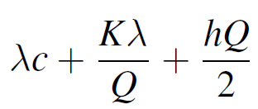
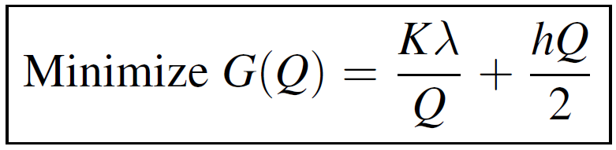
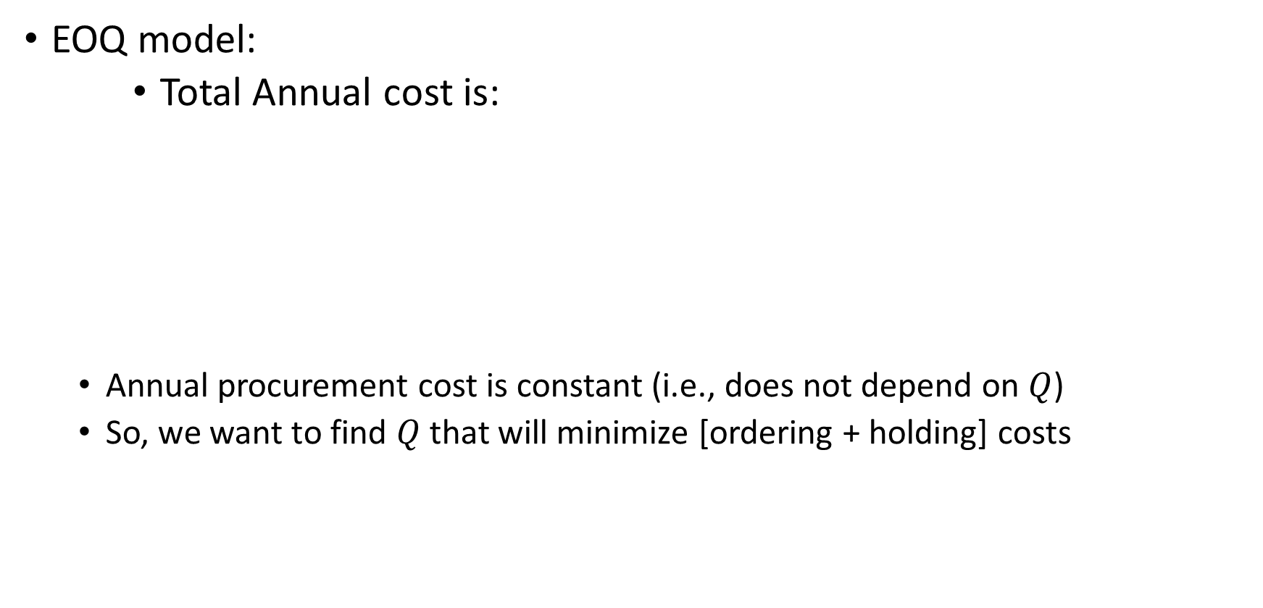
Economic Order Quantity Model
EOQ model:
    Total Annual cost is:
  Annual procurement cost is constant (i.e., does not depend on $Q$)
  So, we want to find $Q$ that will minimize [ordering + holding] costs
Annual inventory holding cost
Annual procurement (including variable transportation) cost
Annual order setup cost

Slide 48
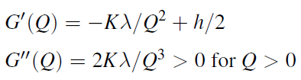
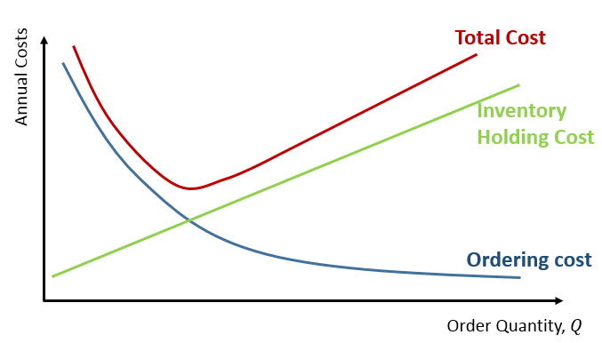

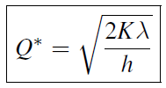

Economic Order Quantity Model
The cost-minimizing order quantity, EOQ:

Slide 49

Simple Linear Regression
Linear Regression:
  You have a set of observations (data points)
  And you want to use these data to explain the relation between two variables
    One variable is explanatory variable X
    The other is the dependent variable Y
    You believe that you have
    So, Y is linearly proportional to X
  Question: Using your observations, find the values of B₀ and B₁ such that the relation between Y and X is best captured (i.e., find the best line)

Slide 50
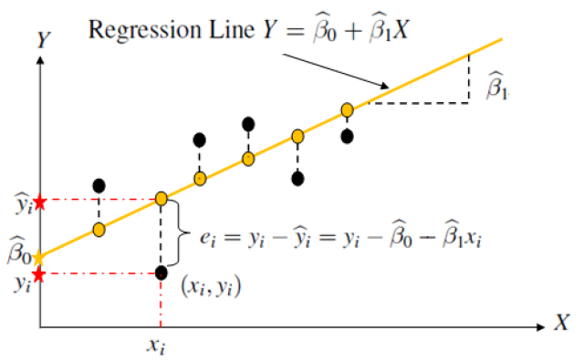
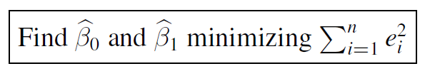
Simple Linear Regression
Least squares method

Slide 51
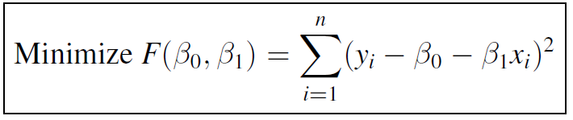
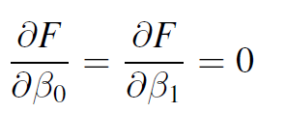
Simple Linear Regression
The optimization
  F is convex… then the optimal solution

